Slide 1
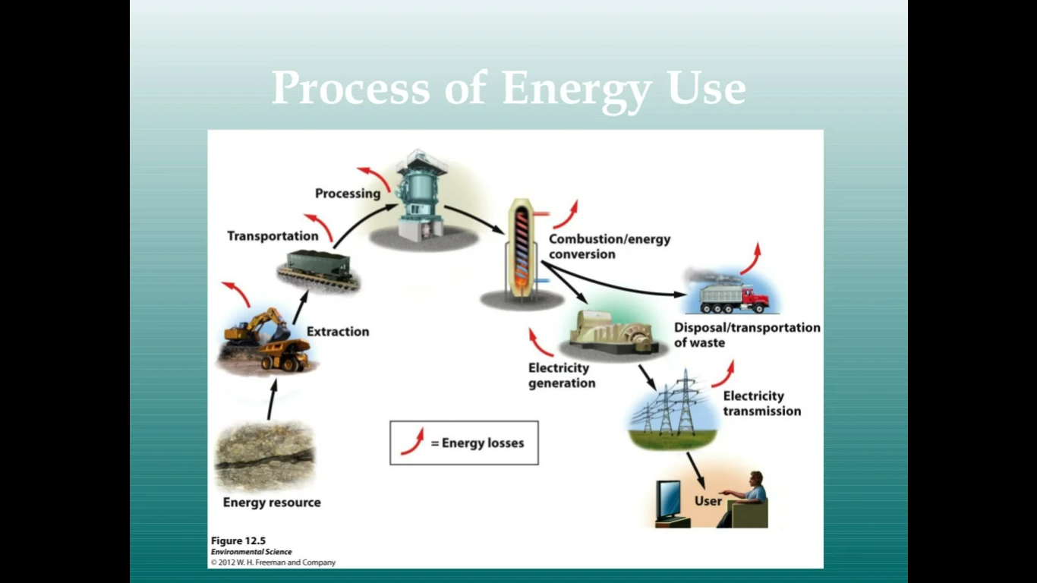

Slide 2
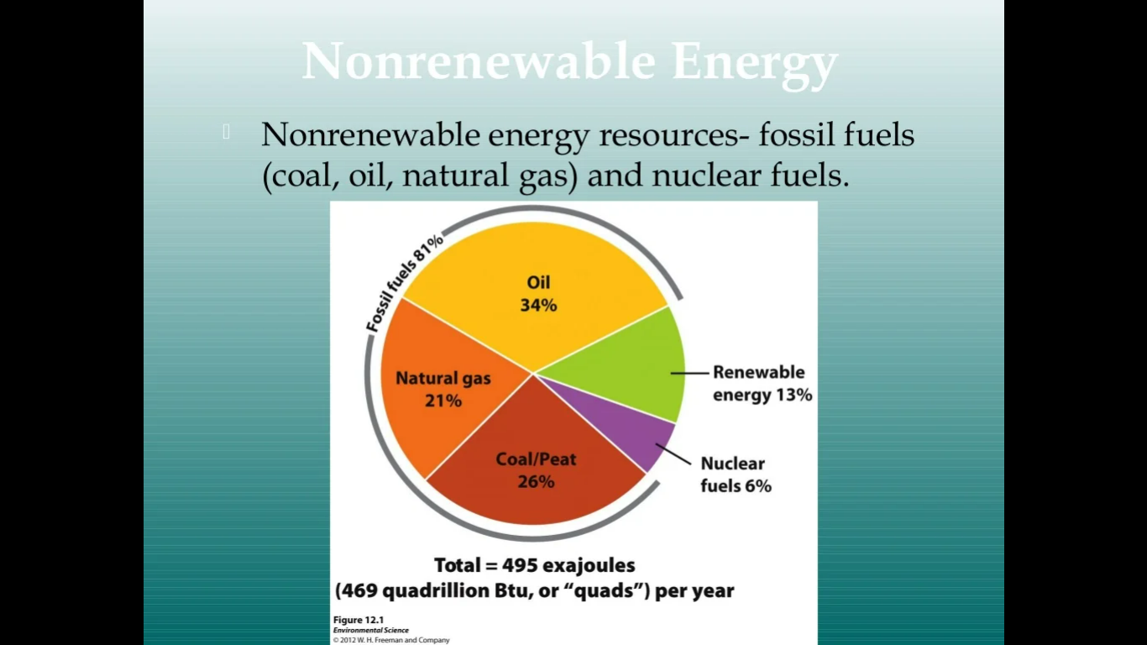

Slide 3
Energy Alternatives: The Imperative Need for Diversification
Energy is the lifeblood of modern society, powering everything from homes and industries to transportation and communication.
However, the predominant reliance on fossil fuels, primarily coal, oil, and natural gas, has led to a range of environmental, economic, and geopolitical challenges.
The urgent need for energy alternatives has emerged as a critical solution to address these issues and secure a sustainable future for our planet.
Environmental Concerns:
The burning of fossil fuels releases greenhouse gases such as carbon dioxide into the atmosphere, contributing to global warming and climate change.
This phenomenon results in rising sea levels, more frequent and severe weather events, and disruptions to ecosystems.
The pollution associated with fossil fuel extraction, transportation, and combustion also leads to air and water pollution, jeopardizing human health and biodiversity.

Slide 4
Finite Resources:
Fossil fuels are finite resources, and their depletion is inevitable.
As these resources become scarcer, their extraction becomes more expensive and environmentally damaging.
Moreover, energy scarcity can lead to geopolitical tensions, as nations compete for access to these diminishing reserves.
Energy Security:
Transitioning to energy alternatives presents economic opportunities by driving innovation, creating jobs, and fostering sustainable economic growth.
Investments in renewable energy technologies, such as solar, wind, and hydropower, can stimulate local economies and encourage research and development in emerging industries.

Slide 5
Health Benefits:
Air pollution caused by burning fossil fuels has dire consequences for public health. Respiratory diseases, cardiovascular issues, and premature deaths are linked to pollutants emitted from conventional energy sources.
Energy alternatives offer cleaner options that can significantly improve air quality and human well-being.
Technological Advances:
Advancements in renewable energy technologies have made them more efficient, affordable, and accessible.
Solar panels and wind turbines are becoming increasingly efficient at harnessing energy from natural sources.
Energy storage technologies, such as batteries, are evolving rapidly, enabling a more reliable integration of intermittent renewable sources into the grid.

Slide 6
Need for Alternatives:
Mitigating Climate Change: The adoption of energy alternatives, particularly renewable sources like solar, wind, and geothermal, can significantly reduce greenhouse gas emissions and mitigate the impacts of climate change.
By transitioning to low-carbon energy sources, we can contribute to a sustainable and habitable planet for future generations.
Resource Conservation:
Energy alternatives, unlike fossil fuels, are sustainable and abundant. Sunlight, wind, and geothermal heat are resources that will not run out in the foreseeable future.
This ensures a reliable and continuous supply of energy without contributing to resource depletion.

Slide 7
Job Creation and Economic Growth:
nvesting in energy alternatives stimulates economic growth and job creation.
The renewable energy sector offers diverse employment opportunities, ranging from manufacturing and construction to research and development.
This fosters local economic resilience and reduces dependence on fluctuating global energy markets.
Energy Security:
Diversifying energy sources enhances energy security by reducing dependence on imported fossil fuels.
Locally generated renewable energy reduces vulnerabilities to supply disruptions, geopolitical conflicts, and price fluctuations in the international energy market.

Slide 8
Improved Air Quality and Public Health:
Energy alternatives produce minimal or no emissions, leading to improved air quality and reduced health risks.
Transitioning away from fossil fuels can alleviate respiratory diseases, cardiovascular problems, and other health issues associated with pollution.
Technological Innovation:
The pursuit of energy alternatives fosters innovation in various fields, including engineering, materials science, and energy storage.
Breakthroughs in these areas have far-reaching implications beyond energy generation, driving progress in multiple industries.

Slide 9
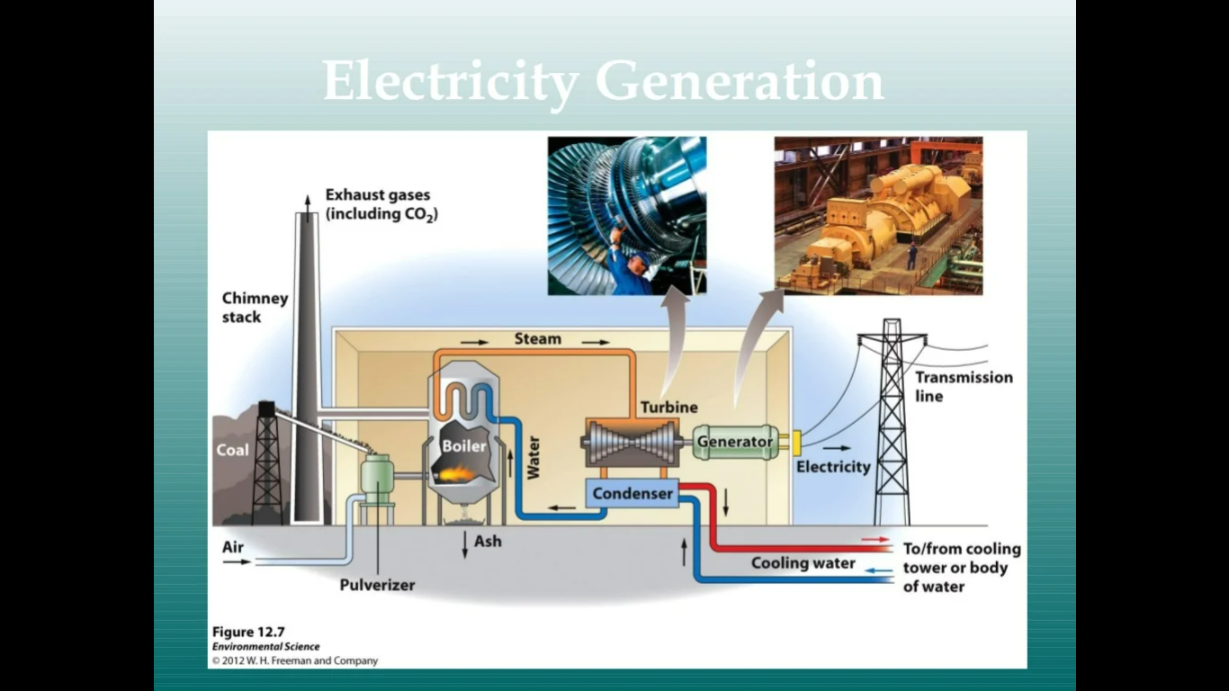

Slide 10
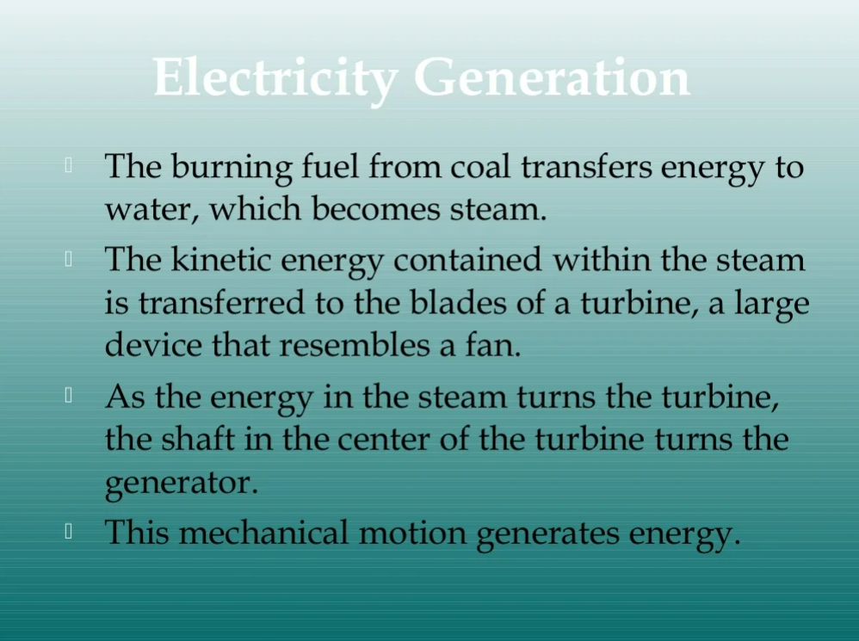

Slide 11
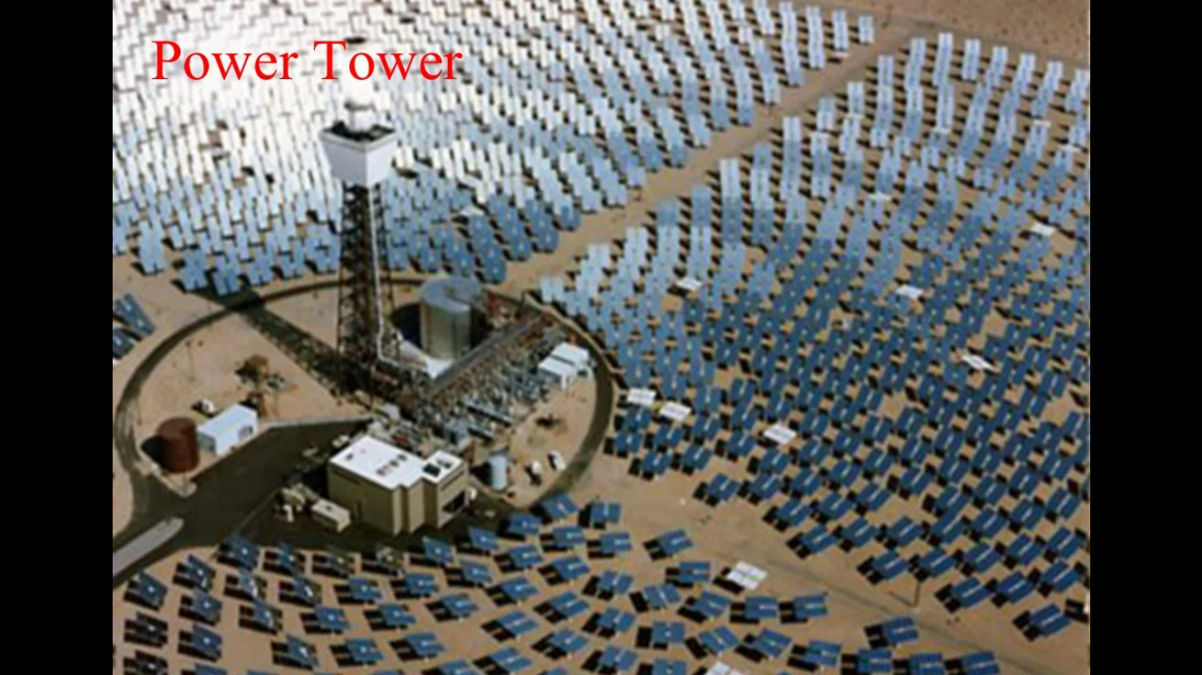

Slide 12
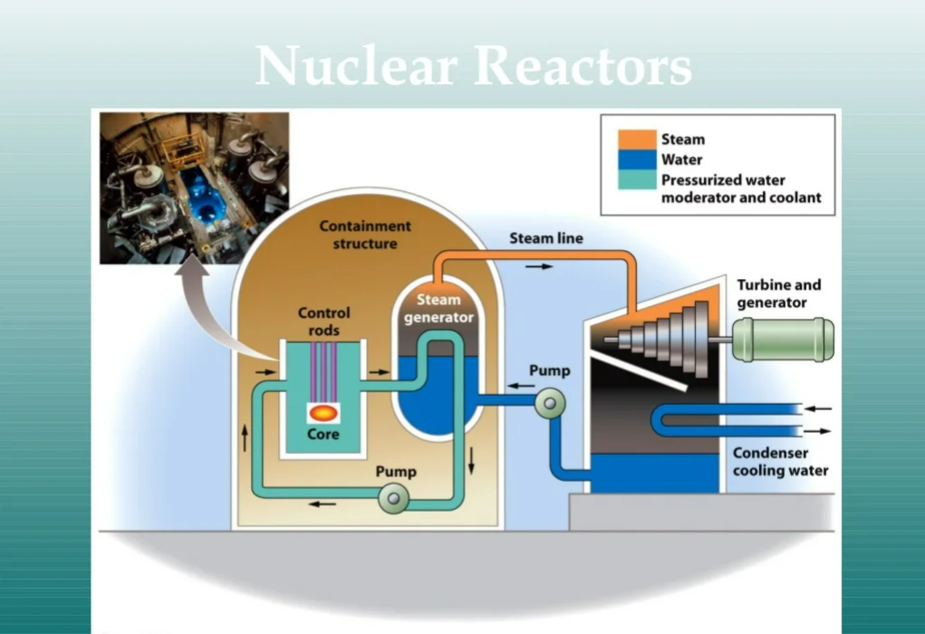

Slide 13
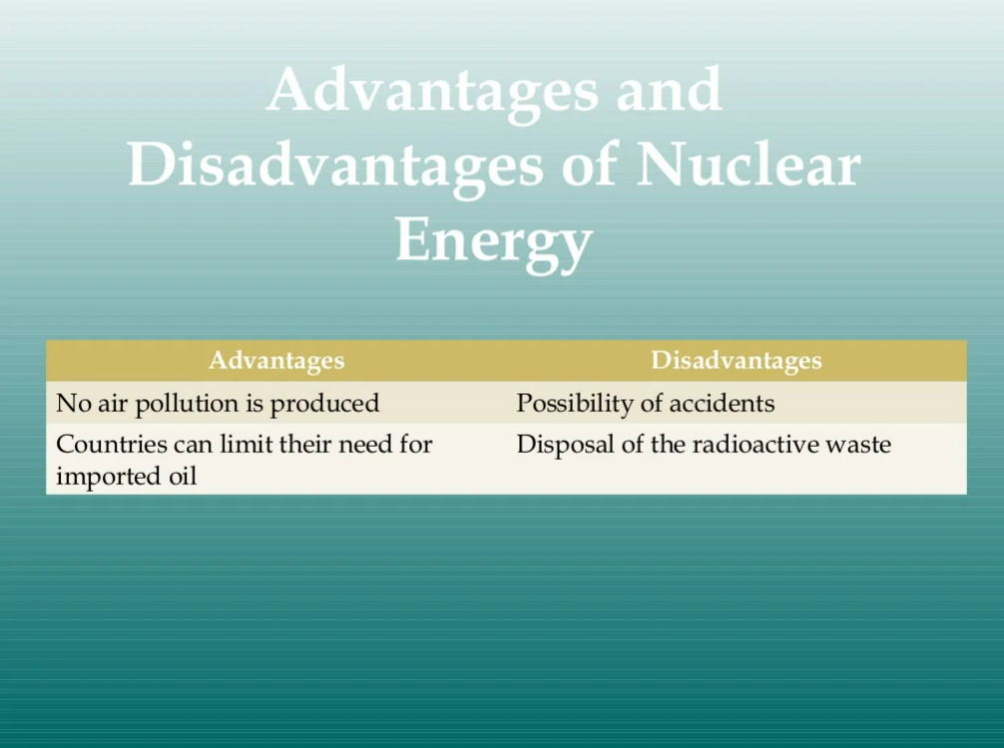

Slide 14
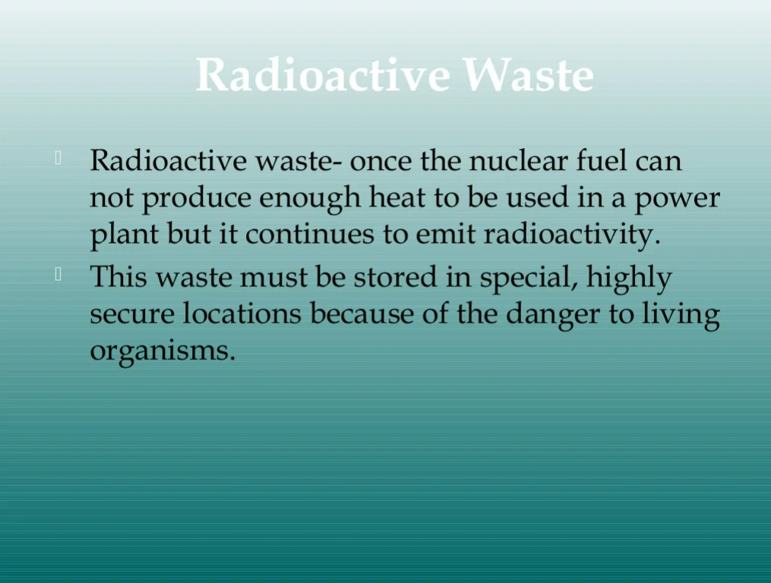

Slide 15
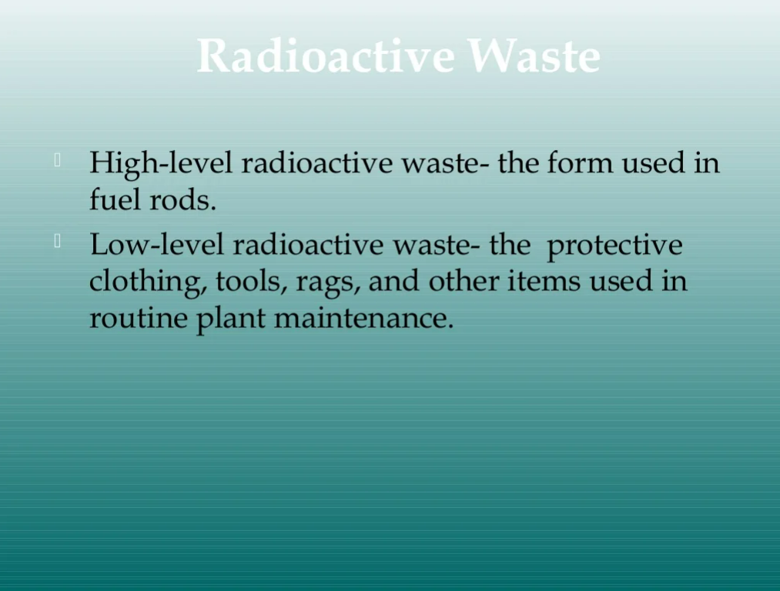

Slide 16
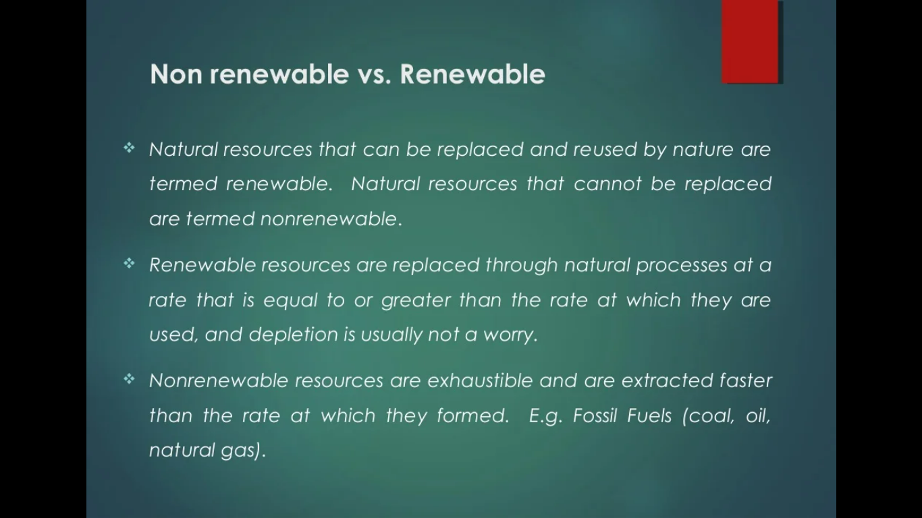

Slide 17
Energy efficiency
Energy efficiency is the process of reducing the amount of energy required to provide products and services. For example, insulating a building allows it to use less heating and cooling energy to achieve and maintain a thermal comfort.
Energy-efficient LED light bulbs are able to produce the same amount of light as incandescent light bulbs by using 75 to 80 percent less electricity.

Slide 18
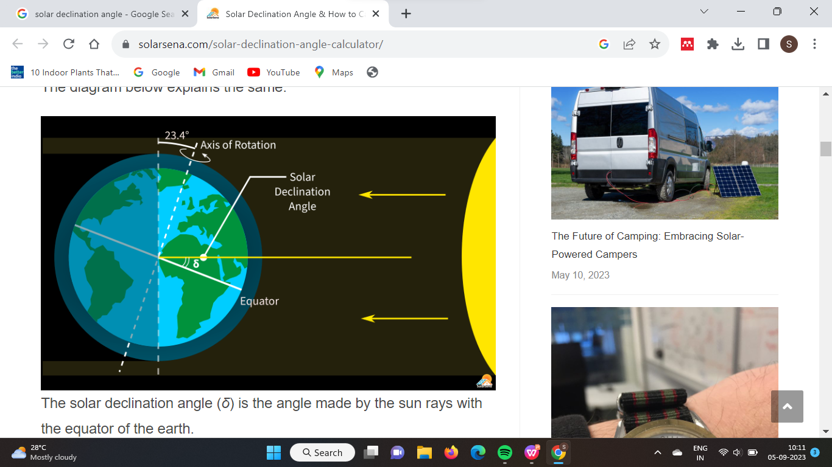
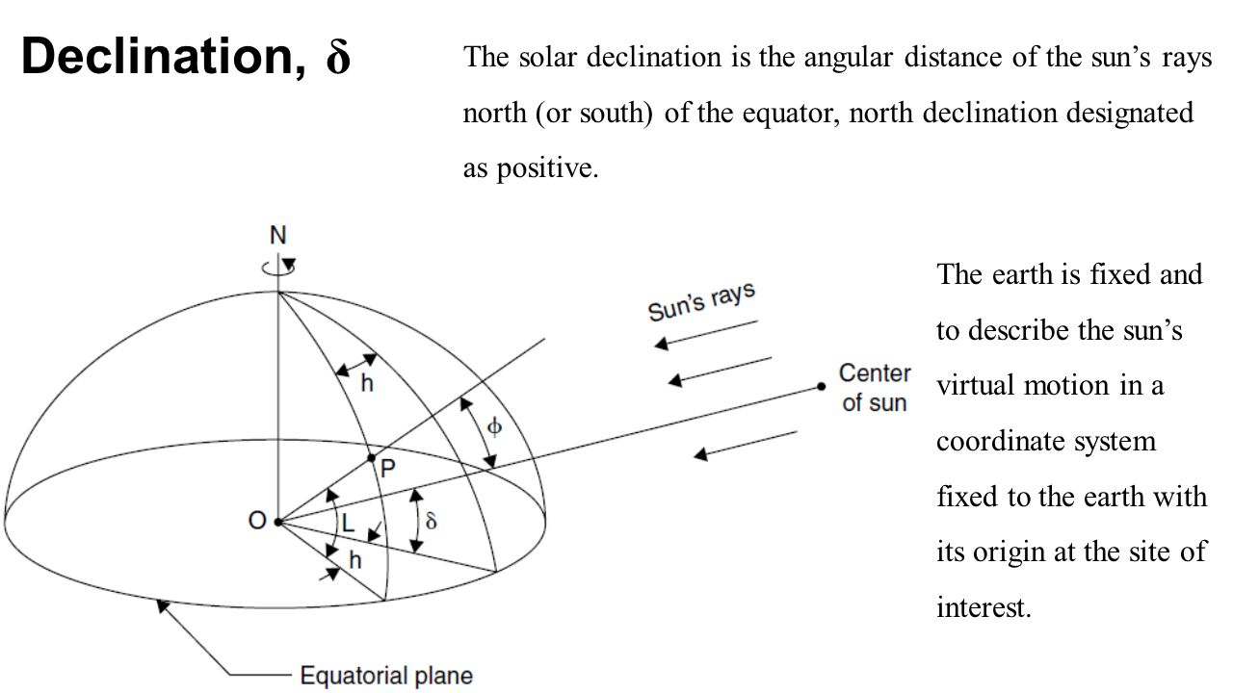
Solar declination is defined as the angle between the line joining the centers of the Sun and the Earth and its projection on the equatorial plane.

Slide 19
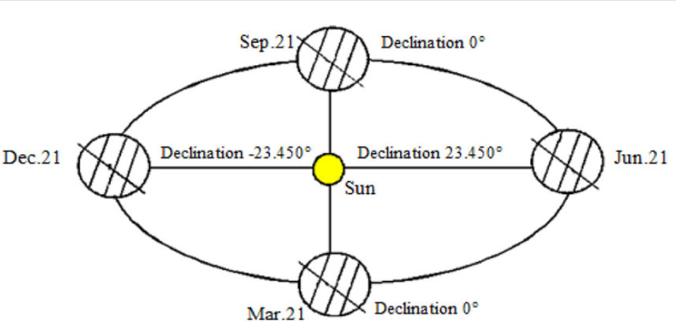

Slide 20
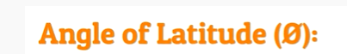
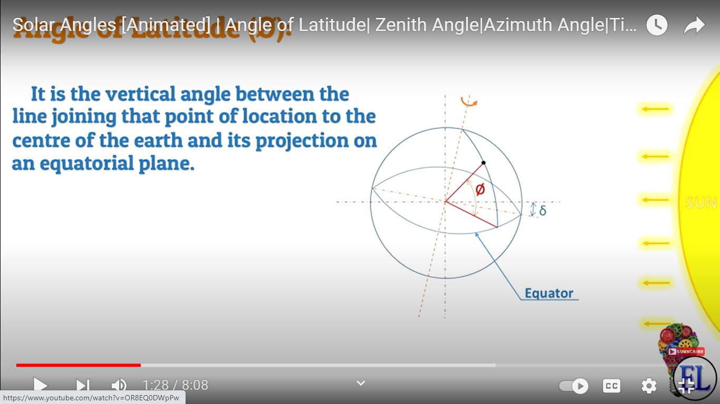

Slide 21
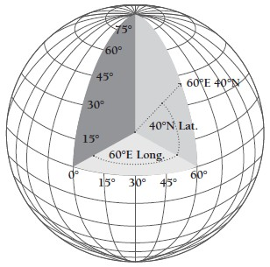
+ in the north pole
- in the south pole

Slide 23
Zenith angle is +90 degrees during sun rise
-90 degrees during sun set

Slide 27
Solar Elevation Angle (Altitude): This angle measures the height of the Sun above the horizon as observed from a specific location on Earth. It ranges from 0° (on the horizon) to 90° (directly overhead). Higher values indicate the Sun is higher in the sky, leading to more direct sunlight and potentially higher temperatures.
Solar Azimuth Angle: This angle defines the direction of the Sun relative to the observer's location. It is measured clockwise from true north. A solar azimuth angle of 0° indicates the Sun is due north, 90° means it's due east, 180° is due south, and 270° is due west.
Solar Declination Angle: This angle measures the latitude at which the Sun's rays are perpendicular to the Earth's surface. It changes throughout the year as the Earth orbits the Sun, causing the seasons. The solar declination angle is 0° during the equinoxes, positive during the northern hemisphere's summer, and negative during its winter.

Slide 28
Hour Angle: This angle measures the time since solar noon, which is the time when the Sun is at its highest point in the sky. It is often expressed in degrees, with 15° per hour of time.
Inclination of Earth's Axis: Earth's axis is tilted relative to its orbital plane around the Sun. This tilt is responsible for the changing seasons as different parts of the Earth receive varying amounts of sunlight throughout the year. The axial tilt is approximately 23.5°.
Angle of Incidence: This angle refers to the angle at which sunlight strikes a surface. The more direct the sunlight, the smaller the angle of incidence, resulting in more concentrated energy per unit area.

Slide 29
Solar Photovoltaic Technology.
Passive Solar Technology.
Solar Water Heating.
Solar Process Heat.
Concentrating Solar Power.

Slide 30
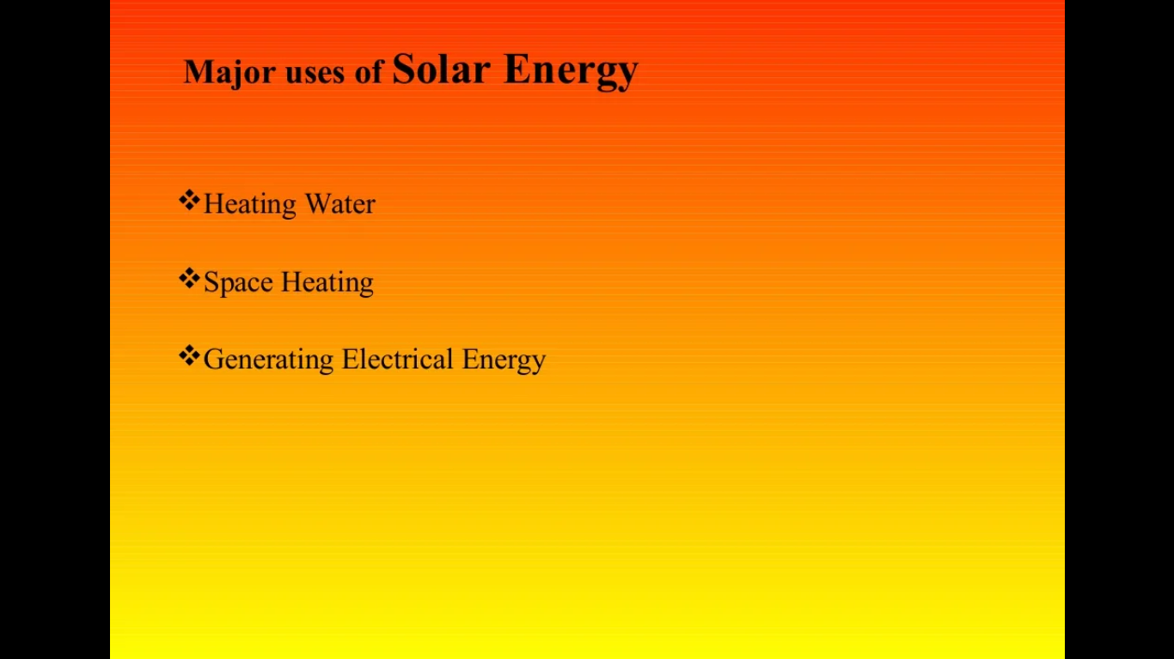

Slide 31
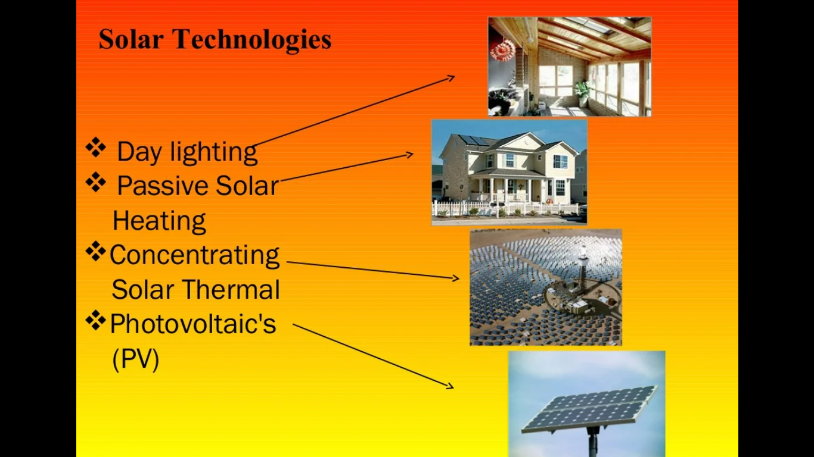

Slide 32
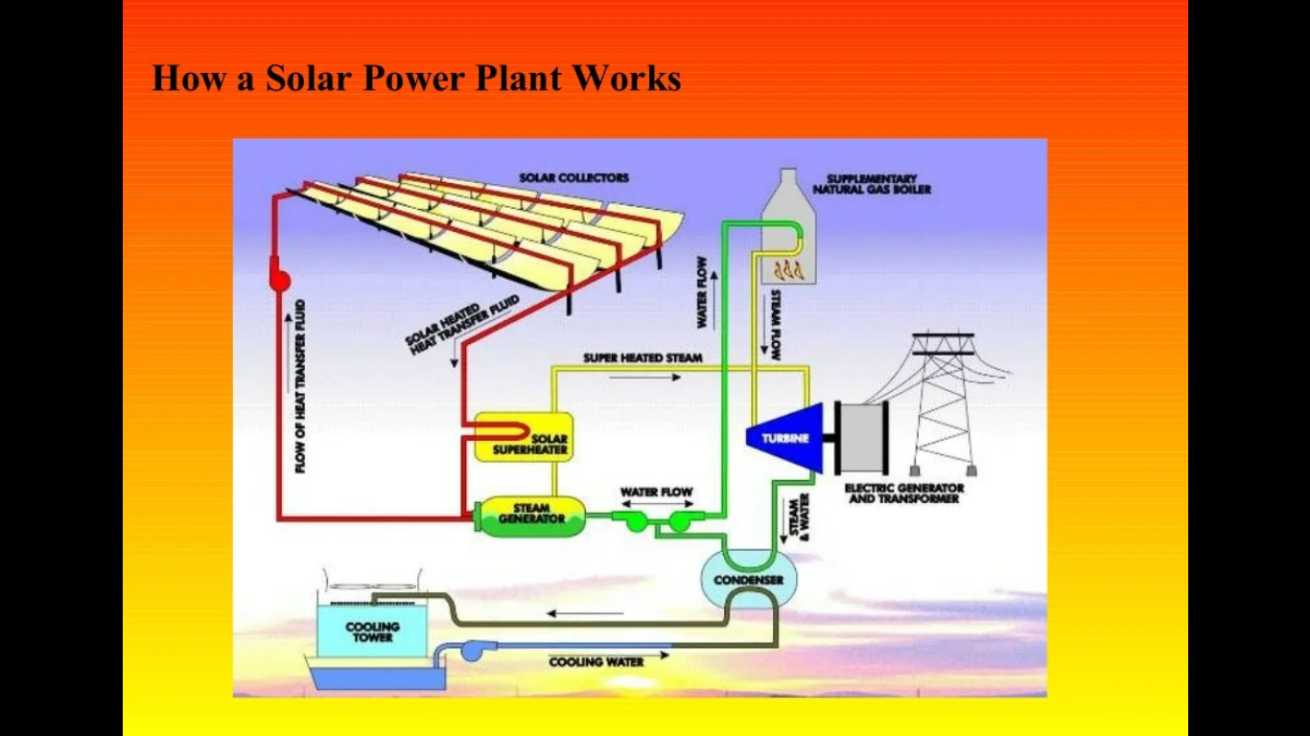

Slide 33

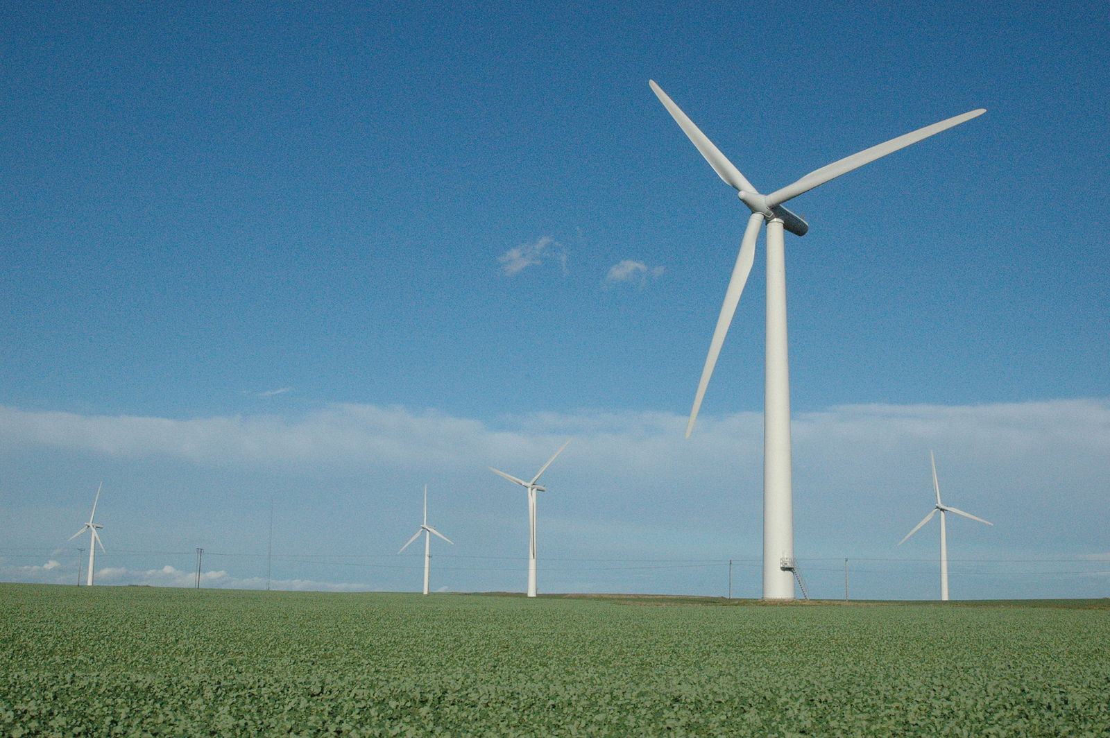
What is a Windmill?
Windmills effective man-made means of power generation that harness the power of wind and use it for a number of functions such as pumping water, saw-milling timber, grinding grain, and so on. Windmills have been around for as long as humans existed on earth
What is a Wind Turbine?
Wind turbine is a mechanical device that uses the kinetic energy of the wind to generate electricity mostly for commercial applications.

Slide 34
Tidal energy is a renewable energy powered by the natural rise and fall of ocean tides and currents.
Some of these technologies include turbines and paddles.

Slide 35
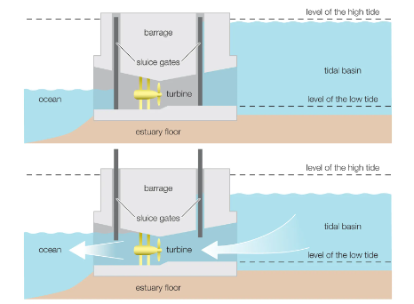

Slide 36
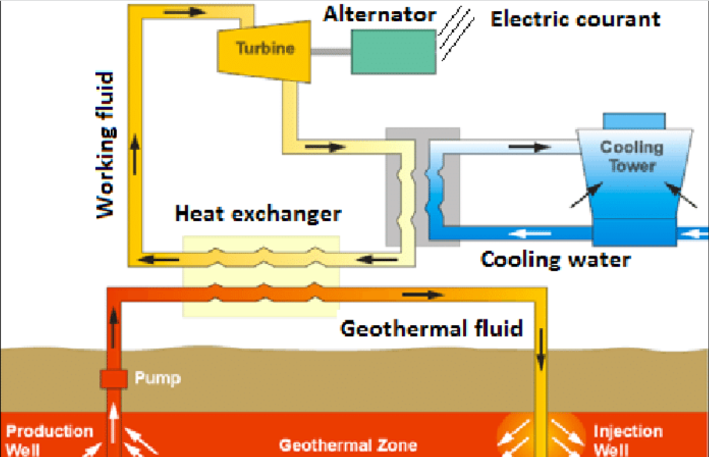
Binary type geothermal system

Slide 37
Components
Production Well
Injection Well
Heat Exchanger
Organic Rankine Cycle (ORC) Turbine
AC Generator
Cooling Tower

Slide 38
Heat from the geothermal fluid causes the secondary fluid to flash to vapor, which then drives the turbines and subsequently, the generators.
A binary cycle power plant is used where geothermal resources are not sufficiently hot to produce steam,
or where the source contains minerals or chemical impurities to allow flashing.
In the binary cycle process, the geothermal liquid is passed through a heat exchanger.
the geothermal water and the working ﬂuid are kept separated during the whole process,
so there are little or no air emissions, and additionally it is able to isolate scaling, gas and erosion problems

Slide 39
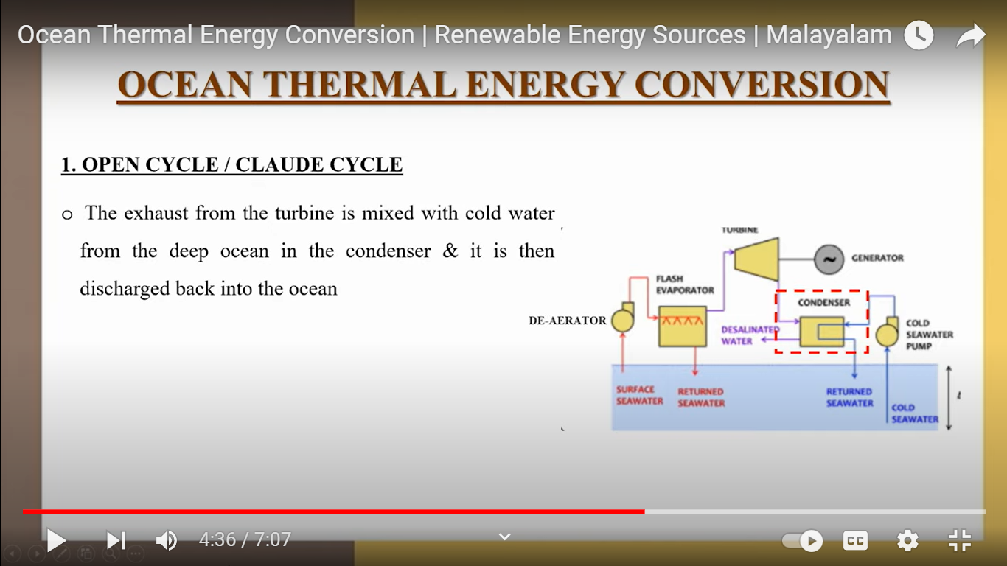

Slide 41
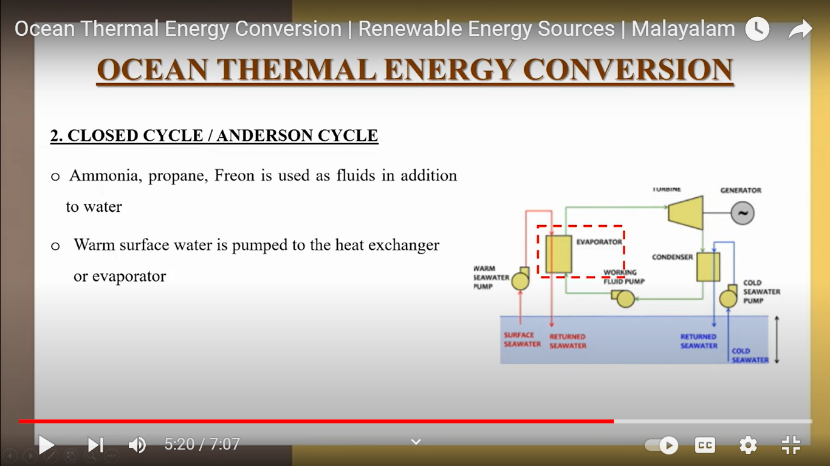

Slide 43
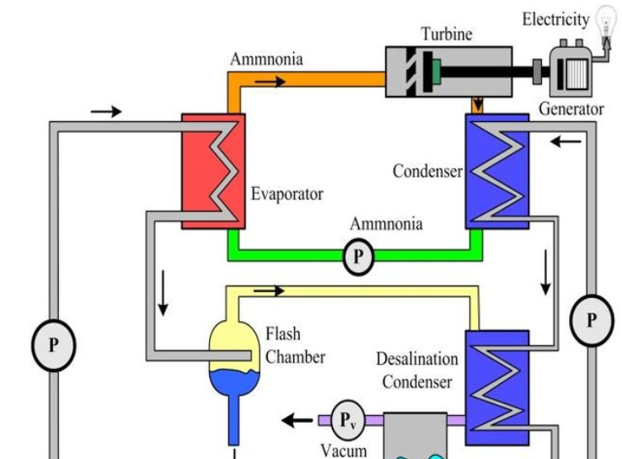
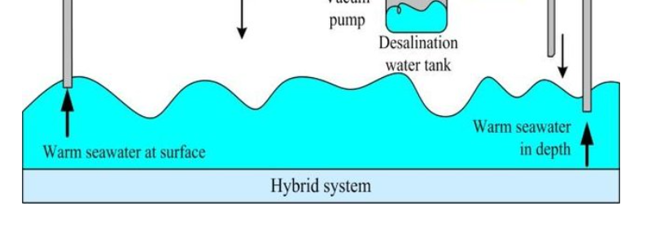

Slide 44
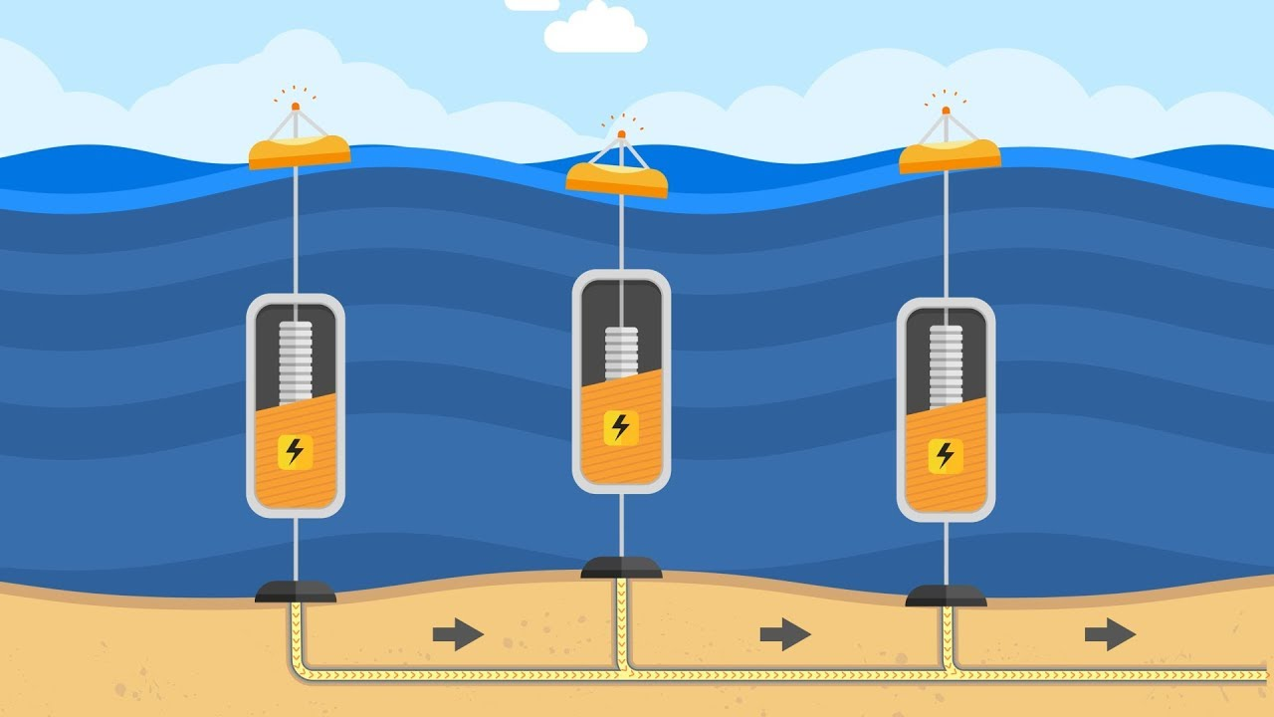

Slide 45
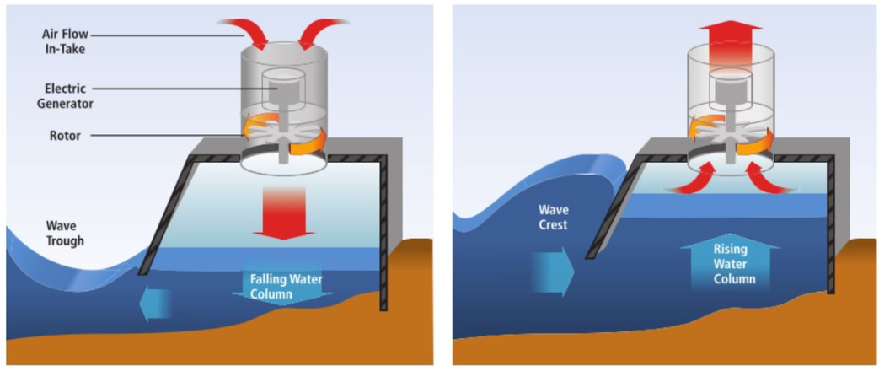
Oscillating Water Columns (OCW)

Slide 46
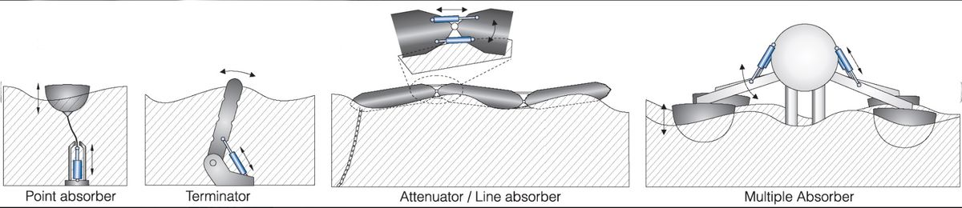

Slide 47
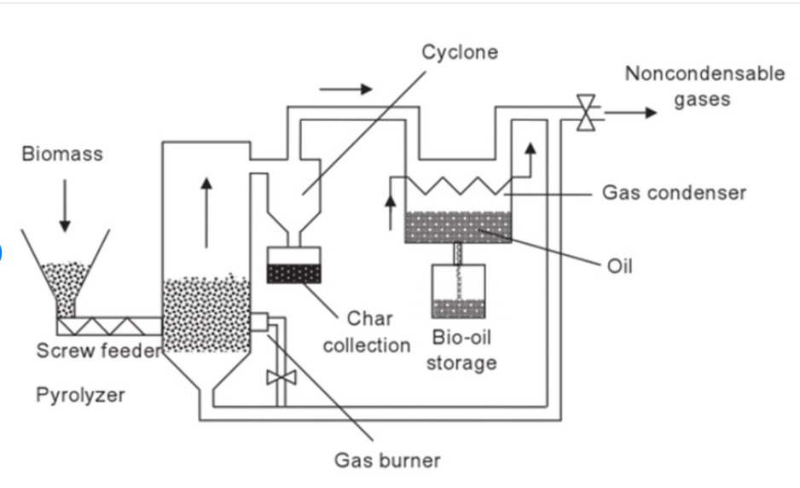

Slide 48
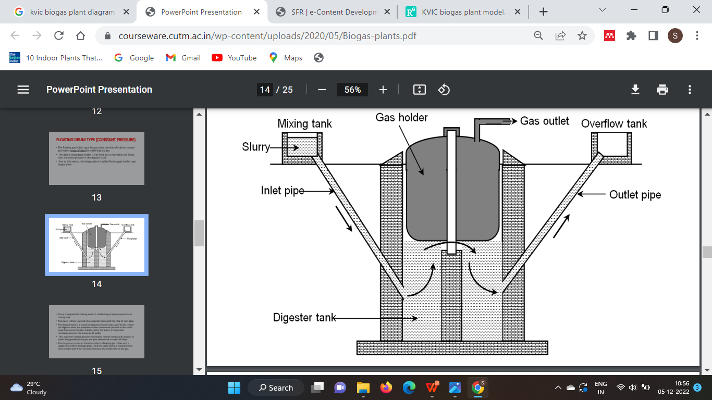
Khadi and Village Industries Commission (KVIC) design of bio gas plant

Slide 49
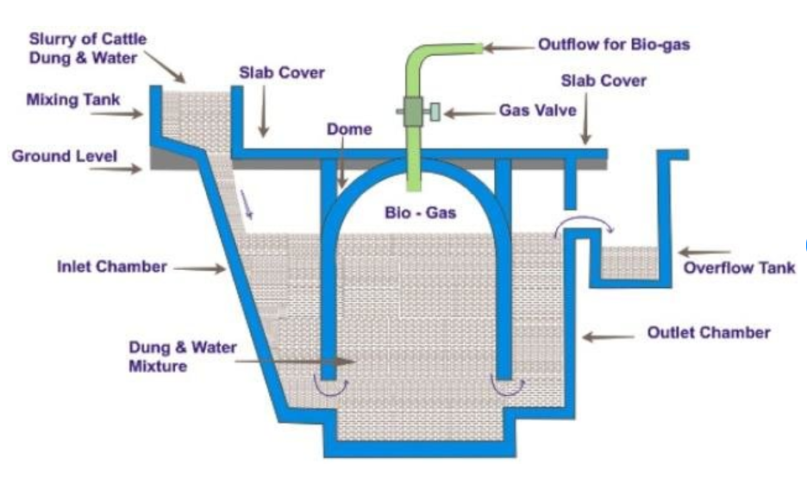
Janatha model

Slide 50
Jantha model have higher capacity when compared with KVIC model
Used as a community biogas plant.
This design has longer life than KVIC models.
Substrates other than cattle dung such as municipal waste and plant residues can also be used in janata type plants.

Slide 51
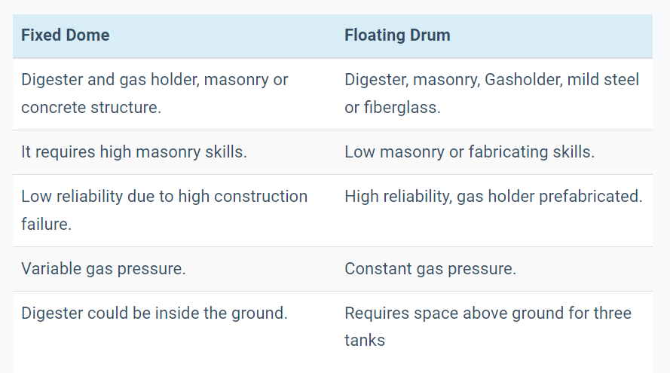

Slide 52
The gasification is a thermo-chemical process that converts any carbon-containing material into a combustible gas by supplying a restricted amount of oxygen.
This gas is known as wood gas, producer gas or syngas, which composed primarily of carbon monoxide and hydrogen as fuels.
Producer gas is generated in the low temperature gasification process (< 1000°C) and contains CO, H2, CH4, CxHy, aliphatic hydrocarbons, benzene, toluene, and tars (besides CO2, H2O, and N2 in case of gasification in air).
H2 and CO typically contain only ~50% of the energy in the gas, while the remainder is in CH4 and higher (aromatic) HCs.
Syngas is produced by high temperature (above 1200°C) or catalytic gasification.
Under these conditions the biomass is completely converted into H2 and CO (besides CO2, H2O, and N2 in case of gasification in air).
Syngas is chemically similar to that derived from fossil sources.

Slide 53
· Pyrolysis
It is the process of conversion of biomass to liquid (bio-oil), solid (charcoal) and gaseous (fuel gases) products by heating in the absence of air at 500 °C.
There are two types of pyrolysis: Fast pyrolysis, conventional (Carbonization) pyrolysis and slow pyrolysis.
Fast pyrolysis process has high heating value and heat transfer rate and completes within seconds. Fast pyrolysis yields 60% bio-oil, 20% bio-char and 20% biogas. in which 80% bio-oil is obtained at keeping temperature low. If flash pyrolysis is used for converting biomass to bio-crude, it has up to 80% efficiency .
Slow pyrolysis process is the process in which mostly carbon (35%) is leaved as residue. Slow pyrolysis takes more time than fast pyrolysis, it also has low temperature and heating values. Flash pyrolysis is the type of fast pyrolysis,

Slide 54
Initial cost means the moneys required for the capital construction or renovation of a facility or the construction of an addition.
Annual Costs means for each Fiscal Year, the total of 1) Authorized Services 2) Administrative Expenses; and 3) any amounts needed to cure actual or estimated delinquencies in Special Taxes for the current or previous Fiscal Year.

Slide 55
We can calculate solar panel payback period by starting with the total cost of installing the solar panels, minus any incentives or rebates you receive. Then just divide the remaining cost by your monthly electric bill savings, until you reach the amount you originally spent.
The average residential solar power system payback is about 8.7 years, but it varies by location and property. So, the typical payback period is about 6 – 10 years.

Slide 56
A person installs a solar panel worth 3 lakh and the state government gives an incentive of 40% of the initial cost of the
panel .The average monthily electricity bill of his house is 3000 rupees.Claculate the pay back time for the solar
panel installation.
Total initial cost of installation =Rs 3,00,000/-
State Govermment incentive = 40% of the Initial Cost
= 0.4 x 3,00,000/-
= 1,20,000/-
Total to be paid for installtion =3,00,000-120000
=1,80,000
Average monthly Electricity bill = 3000/-
Pay back time in months = 1,80,000/3000 = 60 months
=60/12
=5 years

Slide 57
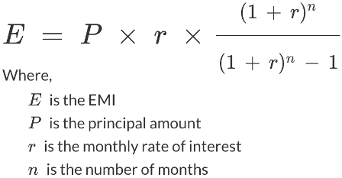
Equal Monthly Installment
The EMI amount is calculated by adding the total principal of the loan and the total interest on the principal together,
then dividing the sum by the number of EMI payments, which is the number of months during the loan term

Slide 58
